Slide 1
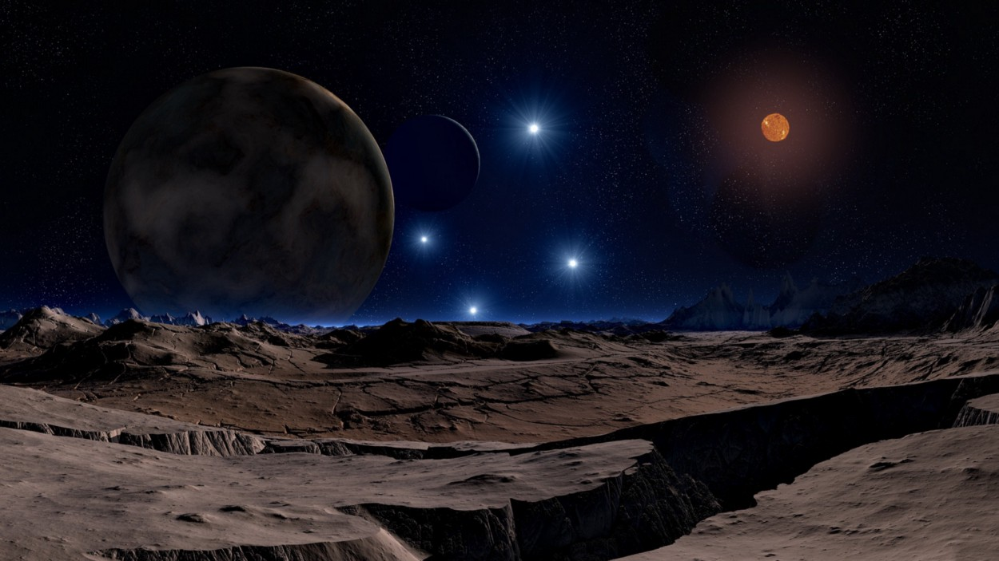
Planet
Habitability Detection
-Subrat yadav(0206AL201065)
Image credit: Lunar Landscape by DasWortewand. CC0 via Pixabay.

Slide 2

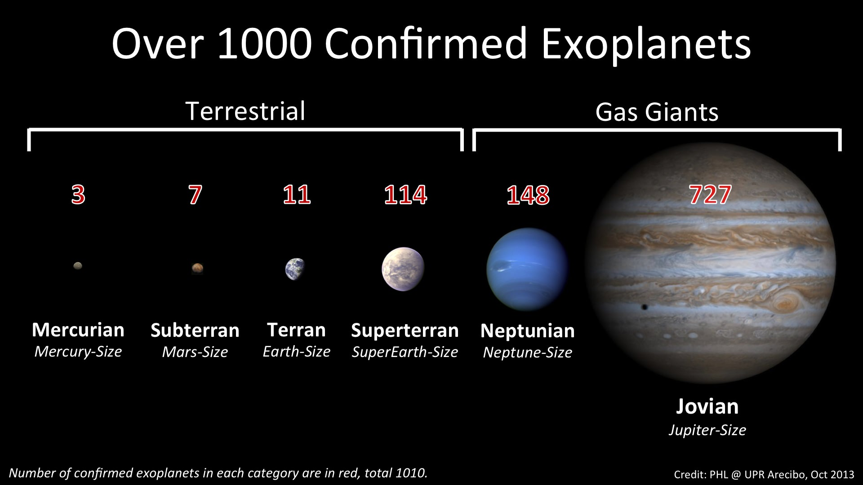

Introductıon
Objectives: I had two objectives when I started the project. One is to measure how effective is machine learning to detect exoplanets. And the other one is to predict whether a planet is habitable or not.
Solution: To accomplish these goals, I used different datasets. I worked on the NASA exoplanet dataset. More info is given in the data knowledge sections.
https://exoplanetarchive.ipac.caltech.edu/cgi-bin/TblView/nph-tblView?app=ExoTbls&config=PS

Slide 3
MOTIVATION
Since my childhood I was wondering or questioning is there any life outside earth? or are we alone?, once a great scientist Carl Sagan stated that “Somewhere, something incredible is waiting to be known.” . So if we are not alone than we want that address of that planet where they are. Basically we need a system which predict by see some features of planet whether the planet is habitable for life or not.
Some People argue that if alien exist than why we still can’t find them or they couldn’t find us. A popular reply given by famous scientist named Nick Tyson with beautiful example he said “Assume you have cup and you want to check whether whale exist in ocean and you just dip cup in ocean and fill the cup with water and you check the cup, oh there is no whale and you assume that rest of ocean also didn’t contains whale” .So basically he was explaning that there is still vast area to explore.

Slide 4
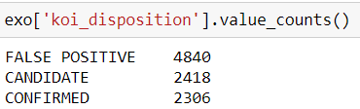
Data & methodology
I extracted the NASA’s exoplanet data from NASA for my project. Dataset contains 9564 rows with 141 columns.
I didn’t use all of the features(coloumns) ,basically extracted top most important features for predicting whether planet is habitable for life or not like –mass of planet,radius of planet,temperature etc.
So I have created my own dataset for my machine learning Model.

Slide 5
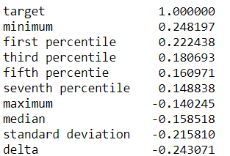
Data & methodology
Feature Engineering
NASA dataset was time-series and not really appropriate for the classic machine learning algorithms, so I made my own dataset that has more characteristic features to work on.
Machine Learning
Defining machine learning algorithms.
Evaluation & Optimization.

Slide 6
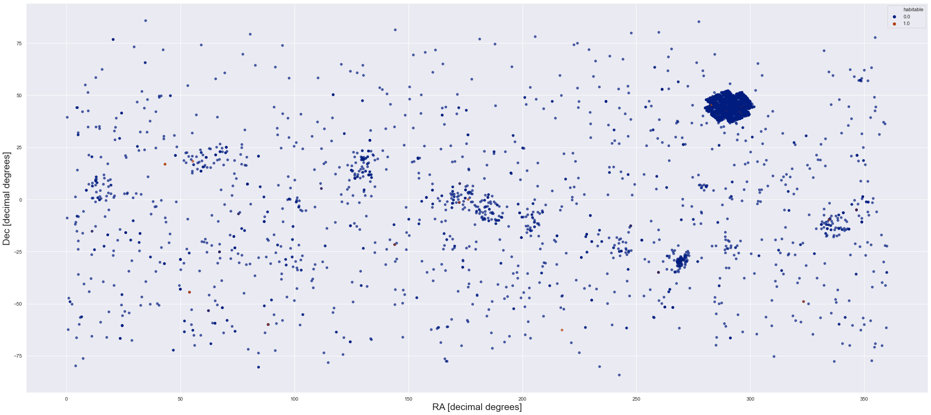
WORK FLOW
The followed methodology in this project is:
Preprocessing and data merging
Handling missing data
EDA/Visualization
Data preparation
Defining machine learning algorithms
Evaluation & Optimization

Slide 7
EXTRACTING the datasets
As I said before, I have one datasets for the project: NASA data. The exoplanet archive from NASA is my main dataset because it has more features from the observed planets & stars.
It has many irrelevant features like distance of planet ,number of rings etc and most of columns doesn’t have value or NAN value.
So I used the most important features like radius , distance of planet from sun etc which are more important for finding habitable planet.
Five important feature I have use are-
-Radius
-Distance
-Temperature of planet
-Mass of planet
-Presence of Liquid water

Slide 8
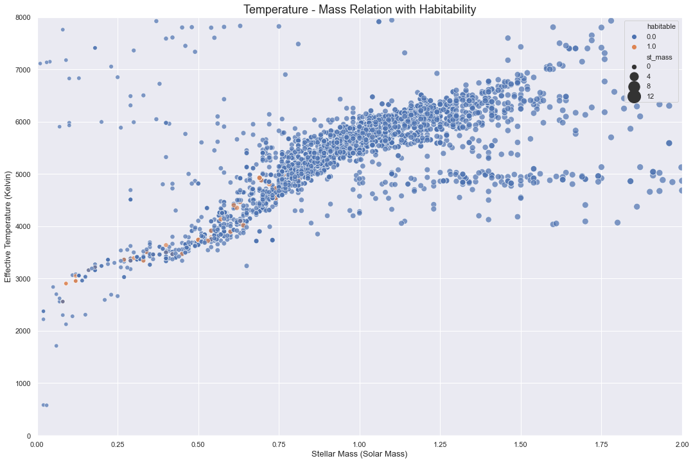

Slide 9
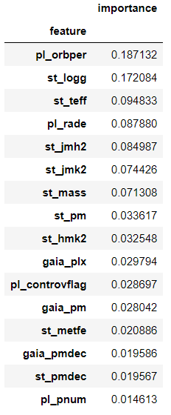
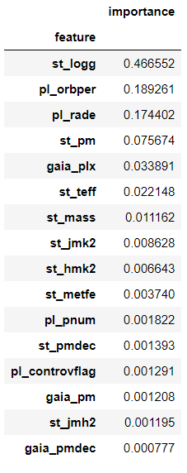
Headıng to machıne learnıng
Defined models:
Logistic Regression
KNN
Linear SVC
Naive Bayes
Decision Trees
Random Forest
Random Forest Decision Tree

Slide 10
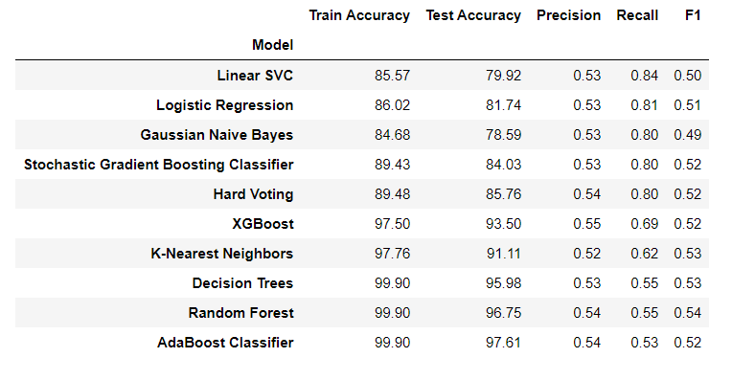
evaluatıon
Performance differences between the different models set.

Slide 11
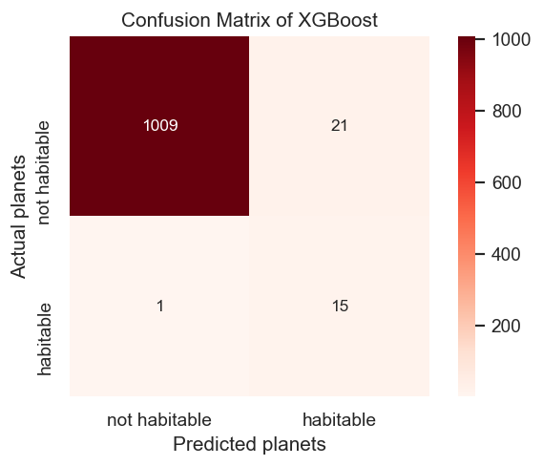
Conclusıons
Kconfution matrix of random forest
Features like planet Radius and stellar surface temp have a significant impact on the model.
Random-Forest is really successful in the task. The model predicted all exoplanets except one.

Slide 12
Further Workıngs
Finding most important features for habitability via NLP work on academic papers.
Adding chemical features if it is possible.
Develop simple web application where we deploy the machine learning model.

Slide 13

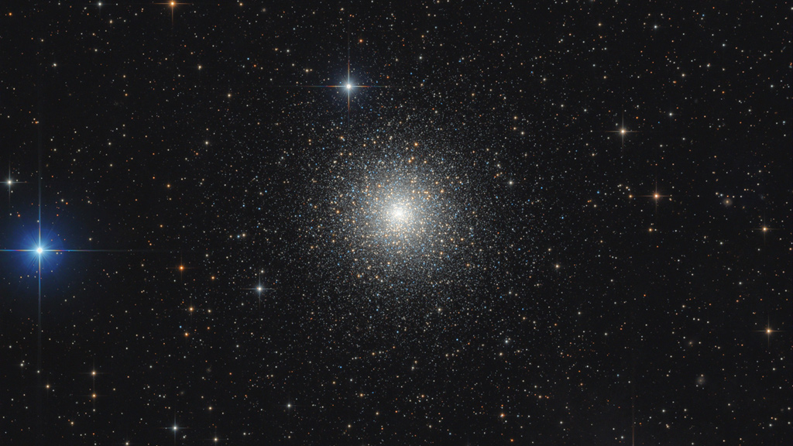

Thank you

